Slide 1

Technical Details
This report contains data collected from patients aged 16+ registered with a GP practice in England.
Data are weighted by age and gender to reflect the population of eligible patients within each practice and CCG.
See the GP Patient Survey website for further information about weighting.
Results
An asterisk (*) indicates a base size of fewer than 10. Where a percentage is below 0.5% it will be displayed as 0%.
Where percentages do not sum to 100, or individual responses do not sum-up to the combined response, this may be due to respondents being able to select multiple responses, computer rounding or the exclusion of ‘don’t know’/ not stated. Where any response is excluded from the combined response, this will be specified.
More information
For more information about the survey please see the: GP Patient Survey website FAQ.

Slide 2
Showing summary results – Response Breakdown
Filters: No filter applied
Showing weighted data
The Valleys – 272 surveys sent out 116 surveys returned
Kiveton Park – 248 surveys sent out 111 surveys returned
Springs Health Centre – 270 surveys sent out 107 surveys returned
NHS Derby and Derbyshire CCG – 33,107 surveys sent out 13,767 surveys returned
National – 2.32 million surveys sent out 770,512 surveys returned

Slide 3
Showing summary results - Q1. Generally, how easy is it to get through to someone at your GP practice on the phone?
Filters: No filter applied
Showing weighted data
Base: All patients excluding haven't tried
Easy = Very easy + Fairly easy. Not easy = Not very easy + Not at all easy
Unweighted Base: Practice 1 (111), Practice 2 (105), Practice 3 (108), CCG 1 (13,299), National (742,537)
Weighted Base: Practice 1 (165), Practice 2 (140), Practice 3 (146), CCG 1 (13,396), National (734,647)
Excluding those who said "Haven’t tried" (weighted): Practice 1 (7), Practice 2 (2), Practice 3 (8), CCG 1 (620), National (33,369)
Note: Differences may not be statistically significant, particularly at practice level due to lower numbers of responses.

Slide 4
Showing summary results - Q2. How helpful do you find the receptionists at your GP practice?
Filters: No filter applied
Showing weighted data
Base: All patients excluding don't know
Helpful = Very helpful + Fairly helpful. Not helpful = Not very helpful + Not at all helpful
Unweighted Base: Practice 1 (115), Practice 2 (105), Practice 3 (107), CCG 1 (13,421), National (751,111)
Weighted Base: Practice 1 (170), Practice 2 (139), Practice 3 (145), CCG 1 (13,579), National (745,548)
Excluding those who said "Don’t know" (weighted): Practice 1 (0), Practice 2 (2), Practice 3 (8), CCG 1 (400), National (20,467)
Note: Differences may not be statistically significant, particularly at practice level due to lower numbers of responses.

Slide 5
Showing summary results - Q8. How satisfied are you with the general practice appointment times that are available to you?
Filters: No filter applied
Showing weighted data
Base: All patients excluding not sure
Satisfied = Very satisfied + Fairly satifsied. Dissatisfied = Fairly dissatisfied + Very dissatisfied
Unweighted Base: Practice 1 (106), Practice 2 (101), Practice 3 (96), CCG 1 (12,448), National (696,898)
Weighted Base: Practice 1 (156), Practice 2 (133), Practice 3 (128), CCG 1 (12,511), National (691,932)
Excluding those who said "I’m not sure when I can get an appointment" (weighted): Practice 1 (3), Practice 2 (0), Practice 3 (4), CCG 1 (166), National (10,341)
Note: Differences may not be statistically significant, particularly at practice level due to lower numbers of responses.

Slide 6
Showing full results - Q10. How often do you see or speak to your preferred GP when you would like to?
Filters: No filter applied
Showing weighted data
Highlighted – where patient experience could improve
Base: All patients who have a GP they prefer to see or speak to, excluding have not tried
Unweighted Base: Practice 1 (41), Practice 2 (51), Practice 3 (41), CCG 1 (6,610), National (382,243)
Weighted Base: Practice 1 (64), Practice 2 (62), Practice 3 (48), CCG 1 (6,108), National (354,719)
Excluding those who said "I have not tried" (weighted): Practice 1 (5), Practice 2 (3), Practice 3 (0), CCG 1 (217), National (13,857)
Note: Differences may not be statistically significant, particularly at practice level due to lower numbers of responses.

Slide 7
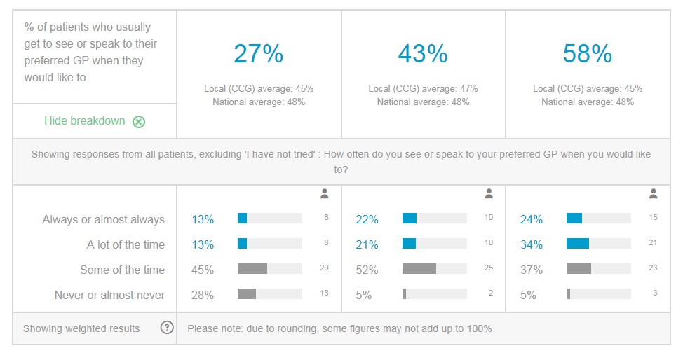
Q.10 Breakdown
The Valleys
Kiveton Park
Springs

Slide 8
Showing full results - Q10. TREND - How often do you see or speak to your preferred GP when you would like to?
Results showing for THE VALLEYS MEDICAL PARTNERSHIP
Filters: No filter applied
Showing weighted data
Base: All patients who have a GP they prefer to see or speak to, excluding have not tried
Unweighted Base: 2018 (54), 2019 (41)
Weighted Base: 2018 (76), 2019 (64)
Excluding those who said "I have not tried" (weighted): 2018 (0), 2019 (5)
Note: Differences may not be statistically significant, particularly at practice level due to lower numbers of responses.

Slide 9
Showing summary results - Q16. On this occasion, were you offered a choice of appointment?
Filters: No filter applied
Showing weighted data
Base: All patients excluding those who have not tried to make an appointment since being registered, excluding can't remember and doesn't apply
Offered a choice = choice of place or time/day or healthcare professional
Unweighted Base: Practice 1 (96), Practice 2 (82), Practice 3 (86), CCG 1 (10,758), National (593,075)
Weighted Base: Practice 1 (139), Practice 2 (108), Practice 3 (116), CCG 1 (10,875), National (592,230)
Excluding those who said "Can’t remember" or "Doesn’t apply" (weighted): Practice 1 (28), Practice 2 (24), Practice 3 (21), CCG 1 (2,143), National (119,677)
Note: Differences may not be statistically significant, particularly at practice level due to lower numbers of responses.

Slide 10
Showing summary results - Q17. Were you satisfied with the type of appointment (or appointments) you were offered?
Filters: No filter applied
Showing weighted data
Base: All patients excluding those who have not tried to make an appointment since being registered
Satisfied = Yes, and I accepted an appointment. Dissatisfied = No, but I still took an appointment + No, and I did not take an appointment
Unweighted Base: Practice 1 (114), Practice 2 (100), Practice 3 (98), CCG 1 (12,822), National (711,867)
Weighted Base: Practice 1 (167), Practice 2 (133), Practice 3 (136), CCG 1 (13,106), National (714,393)
Note: Differences may not be statistically significant, particularly at practice level due to lower numbers of responses.

Slide 11
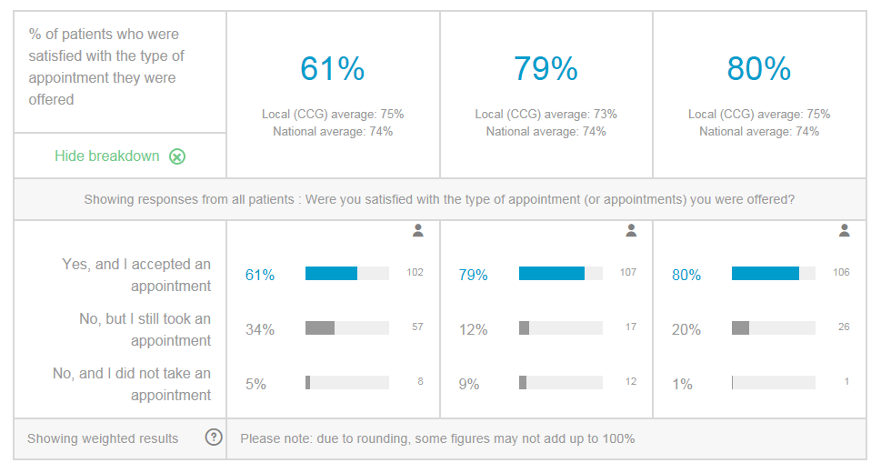
Q.17 Breakdown
The Valleys
Kiveton Park
Springs

Slide 12
Showing summary results - Q17. Were you satisfied with the type of appointment (or appointments) you were offered?
Results showing for THE VALLEYS MEDICAL PARTNERSHIP
Filters: No filter applied
Showing weighted data
Base: All patients excluding those who have not tried to make an appointment since being registered
Satisfied = Yes, and I accepted an appointment. Dissatisfied = No, but I still took an appointment + No, and I did not take an appointment
Unweighted Base: 2018 (107), 2019 (114)
Weighted Base: 2018 (164), 2019 (167)
Note: Differences may not be statistically significant, particularly at practice level due to lower numbers of responses.

Slide 13
Showing full results - Q20. What type of appointment did you get?
Results showing for THE VALLEYS MEDICAL PARTNERSHIP
Filters: No filter applied
Showing weighted data
Base: All patients who accepted an appointment
Unweighted Base: 2018 (90), 2019 (102)
Weighted Base: 2018 (138), 2019 (152)
Note: Differences may not be statistically significant, particularly at practice level due to lower numbers of responses.

Slide 14
Showing summary results - Qxx. Did you take the appointment offered?
Filters: No filter applied
Showing weighted data
Base: All patients excluding those who have not tried to make an appointment since being registered
Satisfied = Yes, and I accepted an appointment. Dissatisfied = No, but I still took an appointment + No, and I did not take an appointment
Unweighted Base: Practice 1 (114), Practice 2 (100), Practice 3 (98), CCG 1 (12,822), National (711,867)
Weighted Base: Practice 1 (167), Practice 2 (133), Practice 3 (136), CCG 1 (13,106), National (714,393)
Note: Differences may not be statistically significant, particularly at practice level due to lower numbers of responses.

Slide 15
Showing summary results - Q22. Overall, how would you describe your experience of making an appointment?
Filters: No filter applied
Showing weighted data
Base: All patients excluding those who have not tried to make an appointment since being registered
Good = Very good + Fairly good. Poor = Fairly poor + Very poor
Unweighted Base: Practice 1 (111), Practice 2 (100), Practice 3 (97), CCG 1 (12,671), National (705,310)
Weighted Base: Practice 1 (164), Practice 2 (133), Practice 3 (135), CCG 1 (12,992), National (708,981)
Note: Differences may not be statistically significant, particularly at practice level due to lower numbers of responses.

Slide 16
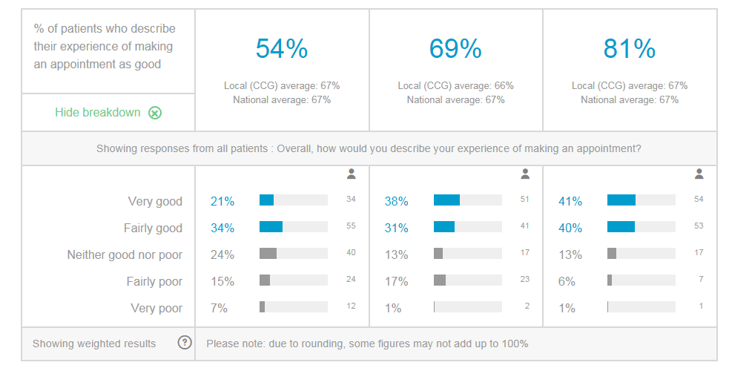
The Valleys
Kiveton Park
Springs

Slide 17
Showing summary results - Q22. Overall, how would you describe your experience of making an appointment?
Results showing for THE VALLEYS MEDICAL PARTNERSHIP
Filters: No filter applied
Showing weighted data
Base: All patients excluding those who have not tried to make an appointment since being registered
Good = Very good + Fairly good. Poor = Fairly poor + Very poor
Unweighted Base: 2018 (108), 2019 (111)
Weighted Base: 2018 (165), 2019 (164)
Note: Differences may not be statistically significant, particularly at practice level due to lower numbers of responses.

Slide 18
Showing summary results - Q25. How long after your appointment time did you wait to see or speak to a healthcare professional?
Filters: No filter applied
Showing weighted data
Base: All patients who had an appointment in the last 12 months, excluding can't remember and I didn't have an appointment at a set time
15 minutes or less = 5 minutes or less + Between 5 and 15 minutes. More than 15 minutes = 15 to 30 minutes + More than 30 minutes
Unweighted Base: Practice 1 (95), Practice 2 (89), Practice 3 (96), CCG 1 (11,163), National (618,419)
Weighted Base: Practice 1 (133), Practice 2 (117), Practice 3 (129), CCG 1 (11,319), National (613,452)
Excluding those who said "I didn’t have an appointment at a set time" or "Can’t remember" (weighted): Practice 1 (32), Practice 2 (15), Practice 3 (16), CCG 1 (1,964), National (104,927)
Note: Differences may not be statistically significant, particularly at practice level due to lower numbers of responses.

Slide 19
Showing summary results - Q26a. Last time you had a general practice appointment, how good was the healthcare professional at giving you enough time?
Filters: No filter applied
Showing weighted data
Base: All patients who had an appointment in the last 12 months, excluding doesn't apply
Good = Very good + Good. Poor = Poor + Very poor
Unweighted Base: Practice 1 (114), Practice 2 (100), Practice 3 (105), CCG 1 (12,933), National (717,030)
Weighted Base: Practice 1 (169), Practice 2 (133), Practice 3 (144), CCG 1 (13,203), National (716,885)
Excluding those who said "Doesn’t apply" (weighted): Practice 1 (0), Practice 2 (1), Practice 3 (0), CCG 1 (178), National (7,923)
Note: Differences may not be statistically significant, particularly at practice level due to lower numbers of responses.

Slide 20
Showing summary results - Q26b. Last time you had a general practice appointment, how good was the healthcare professional at listening to you?
Filters: No filter applied
Showing weighted data
Base: All patients who had an appointment in the last 12 months, excluding doesn't apply
Good = Very good + Good. Poor = Poor + Very poor
Unweighted Base: Practice 1 (114), Practice 2 (101), Practice 3 (105), CCG 1 (12,928), National (715,282)
Weighted Base: Practice 1 (169), Practice 2 (133), Practice 3 (144), CCG 1 (13,239), National (716,337)
Excluding those who said "Doesn’t apply" (weighted): Practice 1 (0), Practice 2 (0), Practice 3 (0), CCG 1 (134), National (7,396)
Note: Differences may not be statistically significant, particularly at practice level due to lower numbers of responses.

Slide 21
Showing summary results - Q26c. Last time you had a general practice appointment, how good was the healthcare professional at treating you with care and concern?
Filters: No filter applied
Showing weighted data
Base: All patients who had an appointment in the last 12 months, excluding doesn't apply
Good = Very good + Good. Poor = Poor + Very poor
Unweighted Base: Practice 1 (114), Practice 2 (101), Practice 3 (105), CCG 1 (12,954), National (717,062)
Weighted Base: Practice 1 (169), Practice 2 (133), Practice 3 (144), CCG 1 (13,232), National (717,472)
Excluding those who said "Doesn’t apply" (weighted): Practice 1 (0), Practice 2 (0), Practice 3 (0), CCG 1 (142), National (6,497)
Note: Differences may not be statistically significant, particularly at practice level due to lower numbers of responses.

Slide 22
Showing summary results - Q27. During your last general practice appointment, did you feel that the healthcare professional recognised and/or understood any mental health needs that you might have had?
Filters: No filter applied
Showing weighted data
Base: All patients who had an appointment in the last 12 months, excluding those who did not have any mental health needs and who say this did not apply to their last appointment
Yes = Yes, definitely + Yes, to some extent
Unweighted Base: Practice 1 (40), Practice 2 (39), Practice 3 (40), CCG 1 (4,925), National (284,999)
Weighted Base: Practice 1 (62), Practice 2 (54), Practice 3 (57), CCG 1 (5,379), National (300,838)
Excluding those who said "I did not have any mental health needs" or "Did not apply to my last appointment" (weighted): Practice 1 (107), Practice 2 (79), Practice 3 (87), CCG 1 (7,815), National (413,781)
Note: Differences may not be statistically significant, particularly at practice level due to lower numbers of responses.

Slide 23
Showing summary results - Q28. During your last general practice appointment, were you involved as much as you wanted to be in decisions about your care and treatment?
Filters: No filter applied
Showing weighted data
Base: All patients who had an appointment in the last 12 months, excluding don't know and doesn't apply
Yes = Yes, definitely + Yes, to some extent
Unweighted Base: Practice 1 (105), Practice 2 (85), Practice 3 (98), CCG 1 (11,564), National (637,385)
Weighted Base: Practice 1 (149), Practice 2 (110), Practice 3 (133), CCG 1 (11,695), National (632,960)
Excluding those who said "Don’t know" or "doesn’t apply" (weighted): Practice 1 (19), Practice 2 (22), Practice 3 (11), CCG 1 (1,649), National (89,144)
Note: Differences may not be statistically significant, particularly at practice level due to lower numbers of responses.

Slide 24
Showing summary results - Q29. During your last general practice appointment, did you have confidence and trust in the healthcare professional you saw or spoke to?
Filters: No filter applied
Showing weighted data
Base: All patients who had an appointment in the last 12 months, excluding don't know /can't say
Yes = Yes, definitely + Yes, to some extent
Unweighted Base: Practice 1 (114), Practice 2 (96), Practice 3 (105), CCG 1 (12,762), National (705,397)
Weighted Base: Practice 1 (169), Practice 2 (128), Practice 3 (144), CCG 1 (12,994), National (703,704)
Excluding those who said "Don’t know" or "can’t say" (weighted): Practice 1 (0), Practice 2 (5), Practice 3 (0), CCG 1 (345), National (19,170)
Note: Differences may not be statistically significant, particularly at practice level due to lower numbers of responses.

Slide 25
Showing summary results - Q30. Thinking about the reason for your last general practice appointment, were your needs met?
Filters: No filter applied
Showing weighted data
Base: All patients who had an appointment in the last 12 months, excluding don't know /can't say
Yes = Yes, definitely + Yes, to some extent
Unweighted Base: Practice 1 (112), Practice 2 (99), Practice 3 (103), CCG 1 (12,810), National (706,338)
Weighted Base: Practice 1 (167), Practice 2 (129), Practice 3 (141), CCG 1 (13,035), National (705,062)
Excluding those who said "Don’t know" or "can’t say" (weighted): Practice 1 (2), Practice 2 (4), Practice 3 (3), CCG 1 (285), National (16,936)
Note: Differences may not be statistically significant, particularly at practice level due to lower numbers of responses.

Slide 26
Showing summary results - Q31. Overall, how would you describe your experience of your GP practice?
Filters: No filter applied
Showing weighted data
Base: All patients
Good = Very good + Fairly good. Poor = Fairly poor + Very poor
Unweighted Base: Practice 1 (115), Practice 2 (107), Practice 3 (110), CCG 1 (13,580), National (760,037)
Weighted Base: Practice 1 (170), Practice 2 (142), Practice 3 (153), CCG 1 (13,884), National (761,244)
Note: Differences may not be statistically significant, particularly at practice level due to lower numbers of responses.

Slide 27
Showing summary results - Q31. Overall, how would you describe your experience of your GP practice?
Results showing for THE VALLEYS MEDICAL PARTNERSHIP
Filters: No filter applied
Showing weighted data
Base: All patients
Good = Very good + Fairly good. Poor = Fairly poor + Very poor
Unweighted Base: 2018 (111), 2019 (115)
Weighted Base: 2018 (171), 2019 (170)
Note: Differences may not be statistically significant, particularly at practice level due to lower numbers of responses.

Slide 28
Showing summary results - Q38. In the last 12 months, have you had enough support from local services or organisations to help you to manage your condition (or conditions)?
Filters: No filter applied
Showing weighted data
Base: All patients with a long-term condition, excluding those who haven't needed support and don't/can't say
Yes = Yes, definitely + Yes, to some extent
Unweighted Base: Practice 1 (41), Practice 2 (50), Practice 3 (41), CCG 1 (5,422), National (292,168)
Weighted Base: Practice 1 (48), Practice 2 (63), Practice 3 (46), CCG 1 (5,046), National (262,727)
Excluding those who said "I haven’t needed support" or "Don’t know/ Can’t say" (weighted): Practice 1 (24), Practice 2 (25), Practice 3 (28), CCG 1 (2,201), National (111,503)
Note: Differences may not be statistically significant, particularly at practice level due to lower numbers of responses.

